Slide 1
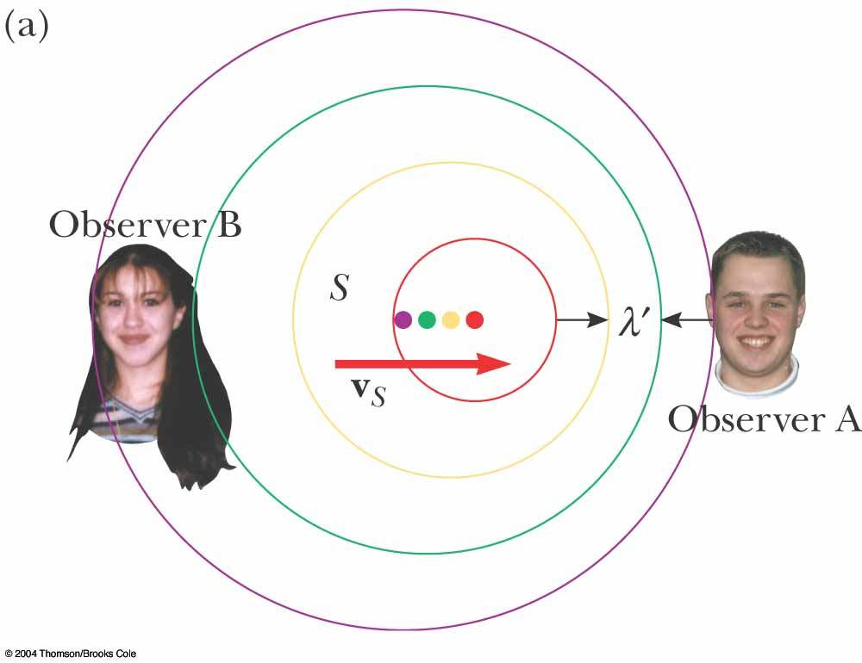

Slide 2
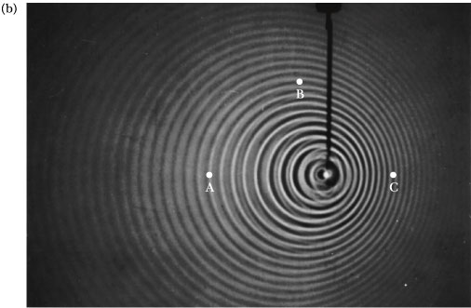
Fig. 17.9b, p.524
Notes:
Active Figure 17.9 (b) The Doppler effect in water, observed in a ripple tank. A point source is moving to the right with speed v_{S}. Letters shown in the photo refer to Quick Quiz 17.7.

